Slide 1
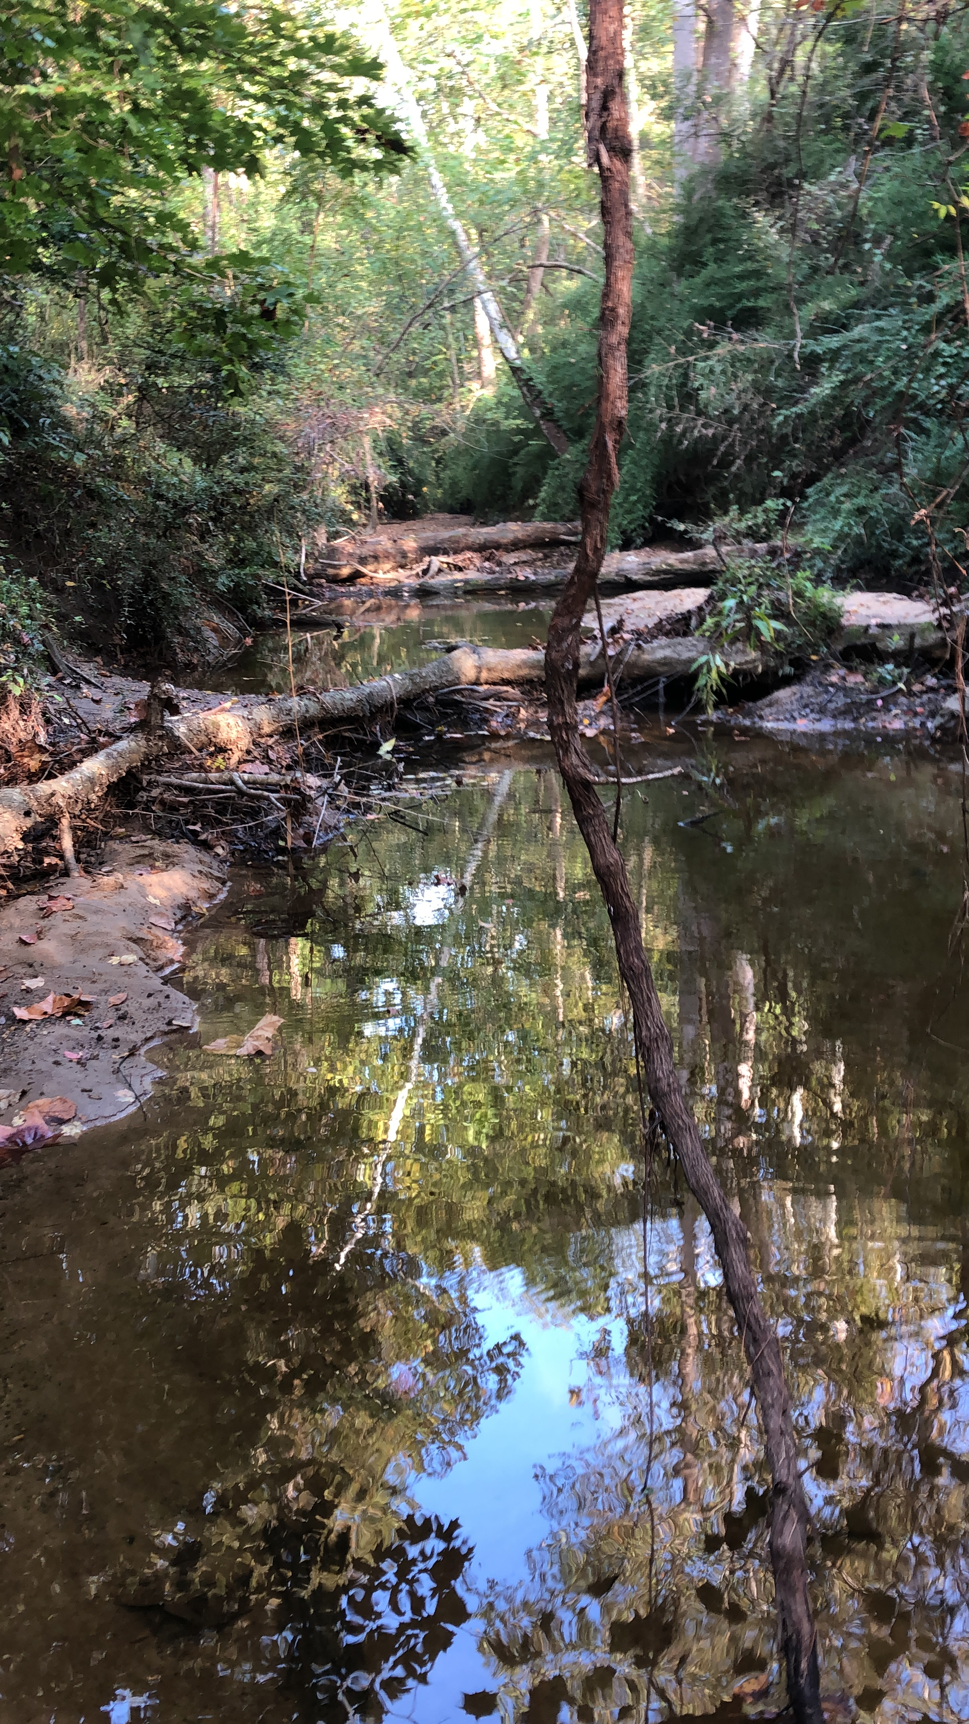
How Does Riparian Land Use Impact the Water Chemistry of an Urban Stream?
Kriddie Whitmore

Slide 2
Outline
Motivation
Research Questions
Study Design
Field Data Collection
Remote Sensing
Final Analysis
Conclusions
Next Steps

Slide 3
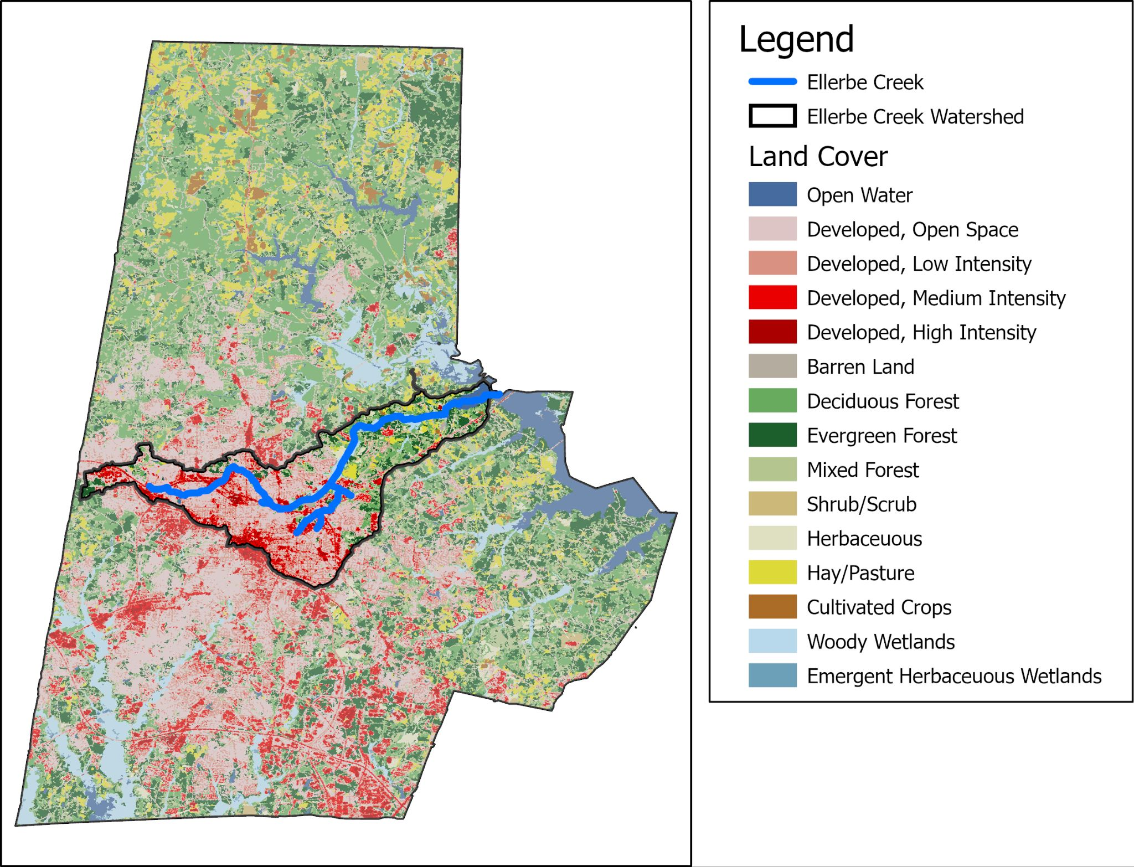
Ellerbe Creek Watershed
Runs through downtown Durham
Highly urbanized
Listed as impared by EPA
Flows into Falls Lake - an important source for drinking water

Slide 4
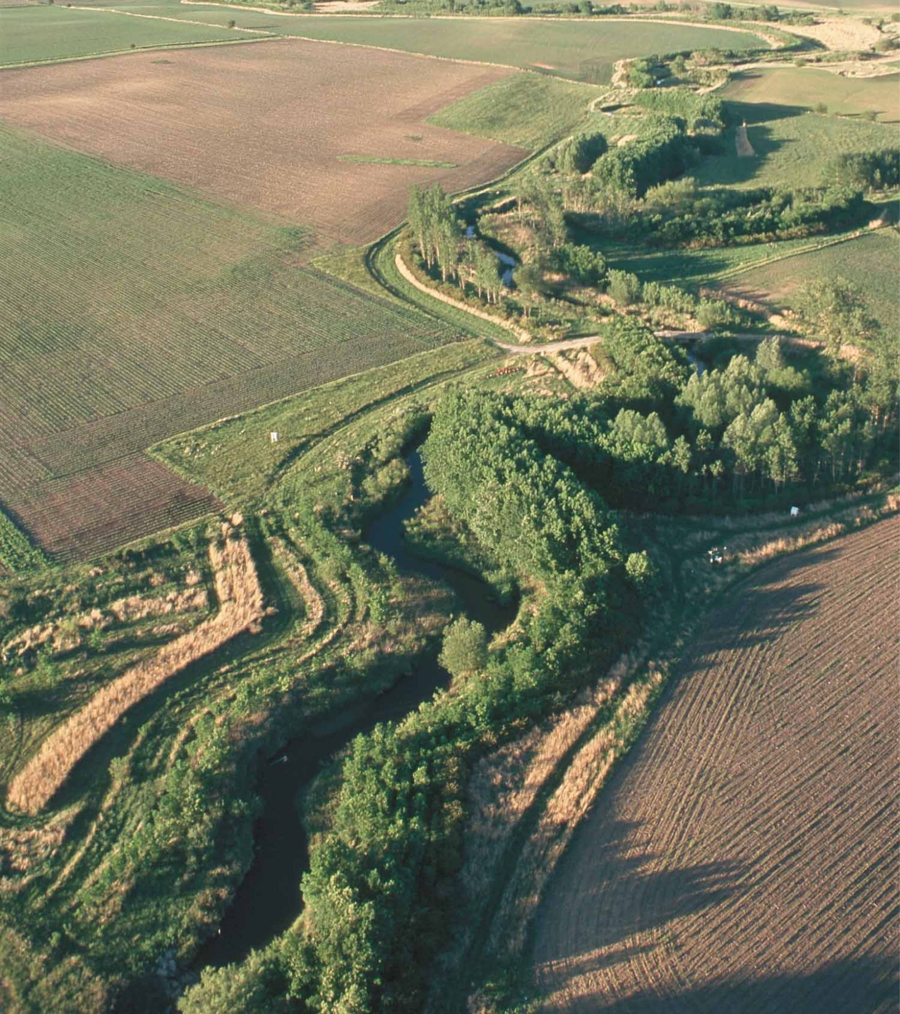
Riparian Buffers
Undeveloped land along banks of a river
Found to reduce nitrogen pollution
Legally required by state and federal agencies
(buffer distance inconsistent)

Slide 5
Research Questions
What is the value of protecting riparian land, in terms of pollutant reduction?
What characteristics of riparian buffers influence chemistry?
Riparian buffer width
Riparian land cover

Slide 6
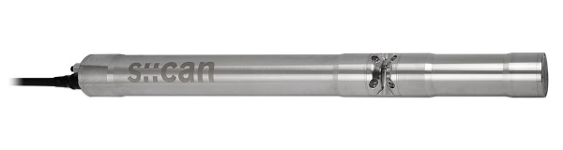
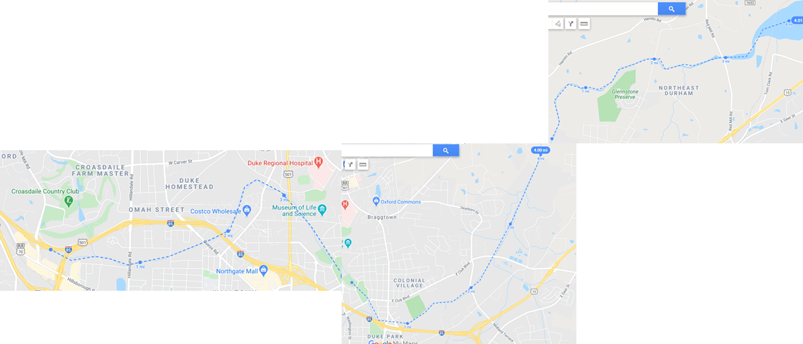
Study Design
Synoptic sampling at high spatial resolution
Nitrate, nitrite and other major anion, dissolved organic carbon
From headwaters to outflow (12 miles)
Pair Measurements with riparian land use /land cover

Slide 7
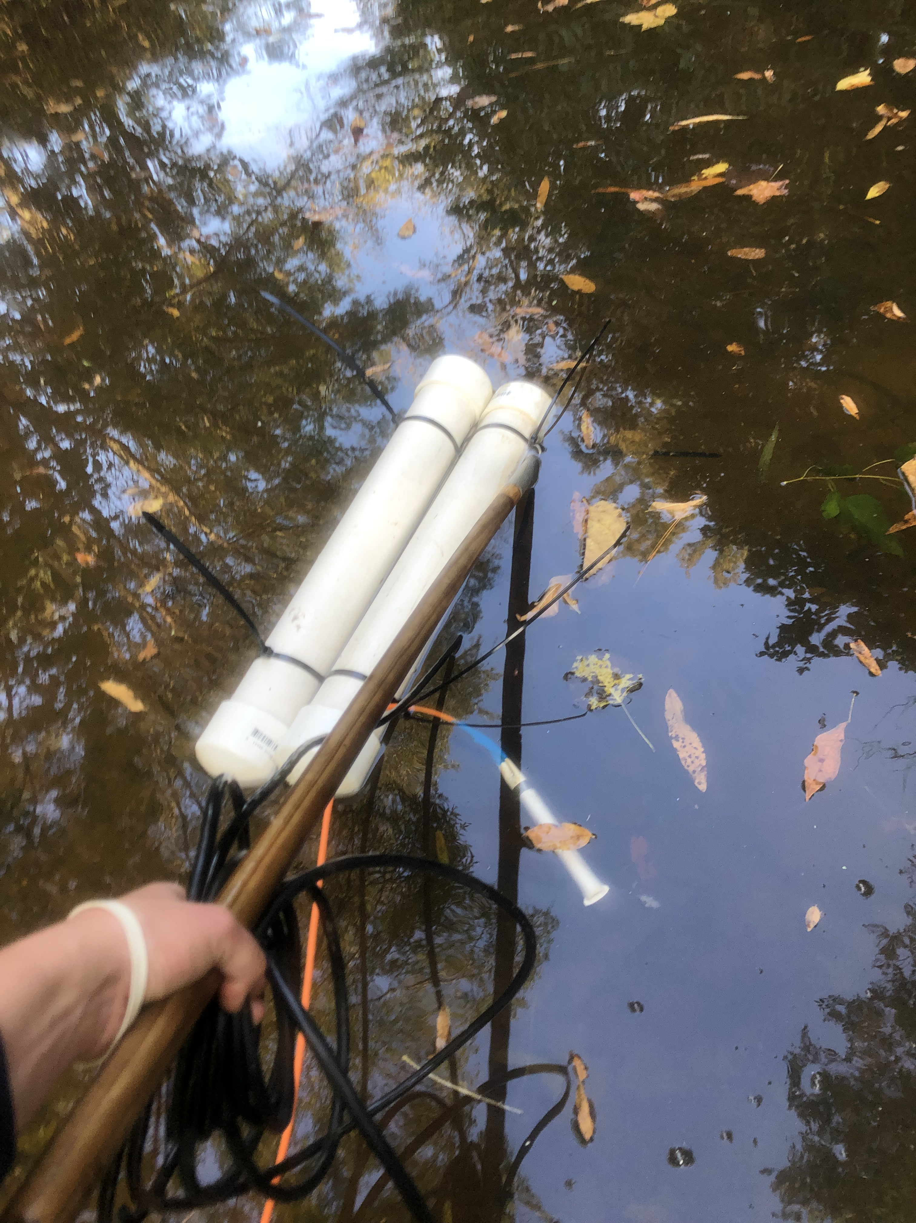
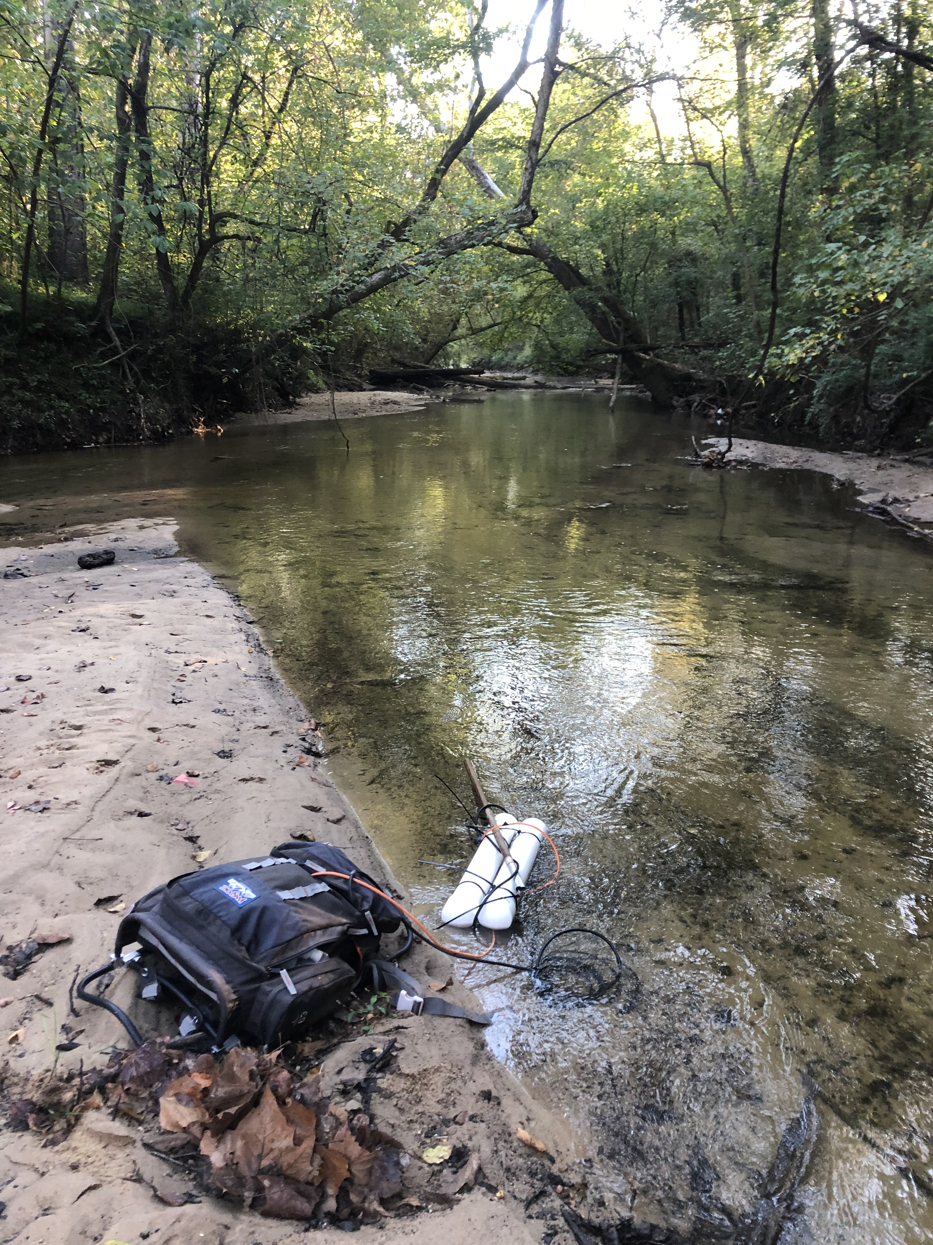
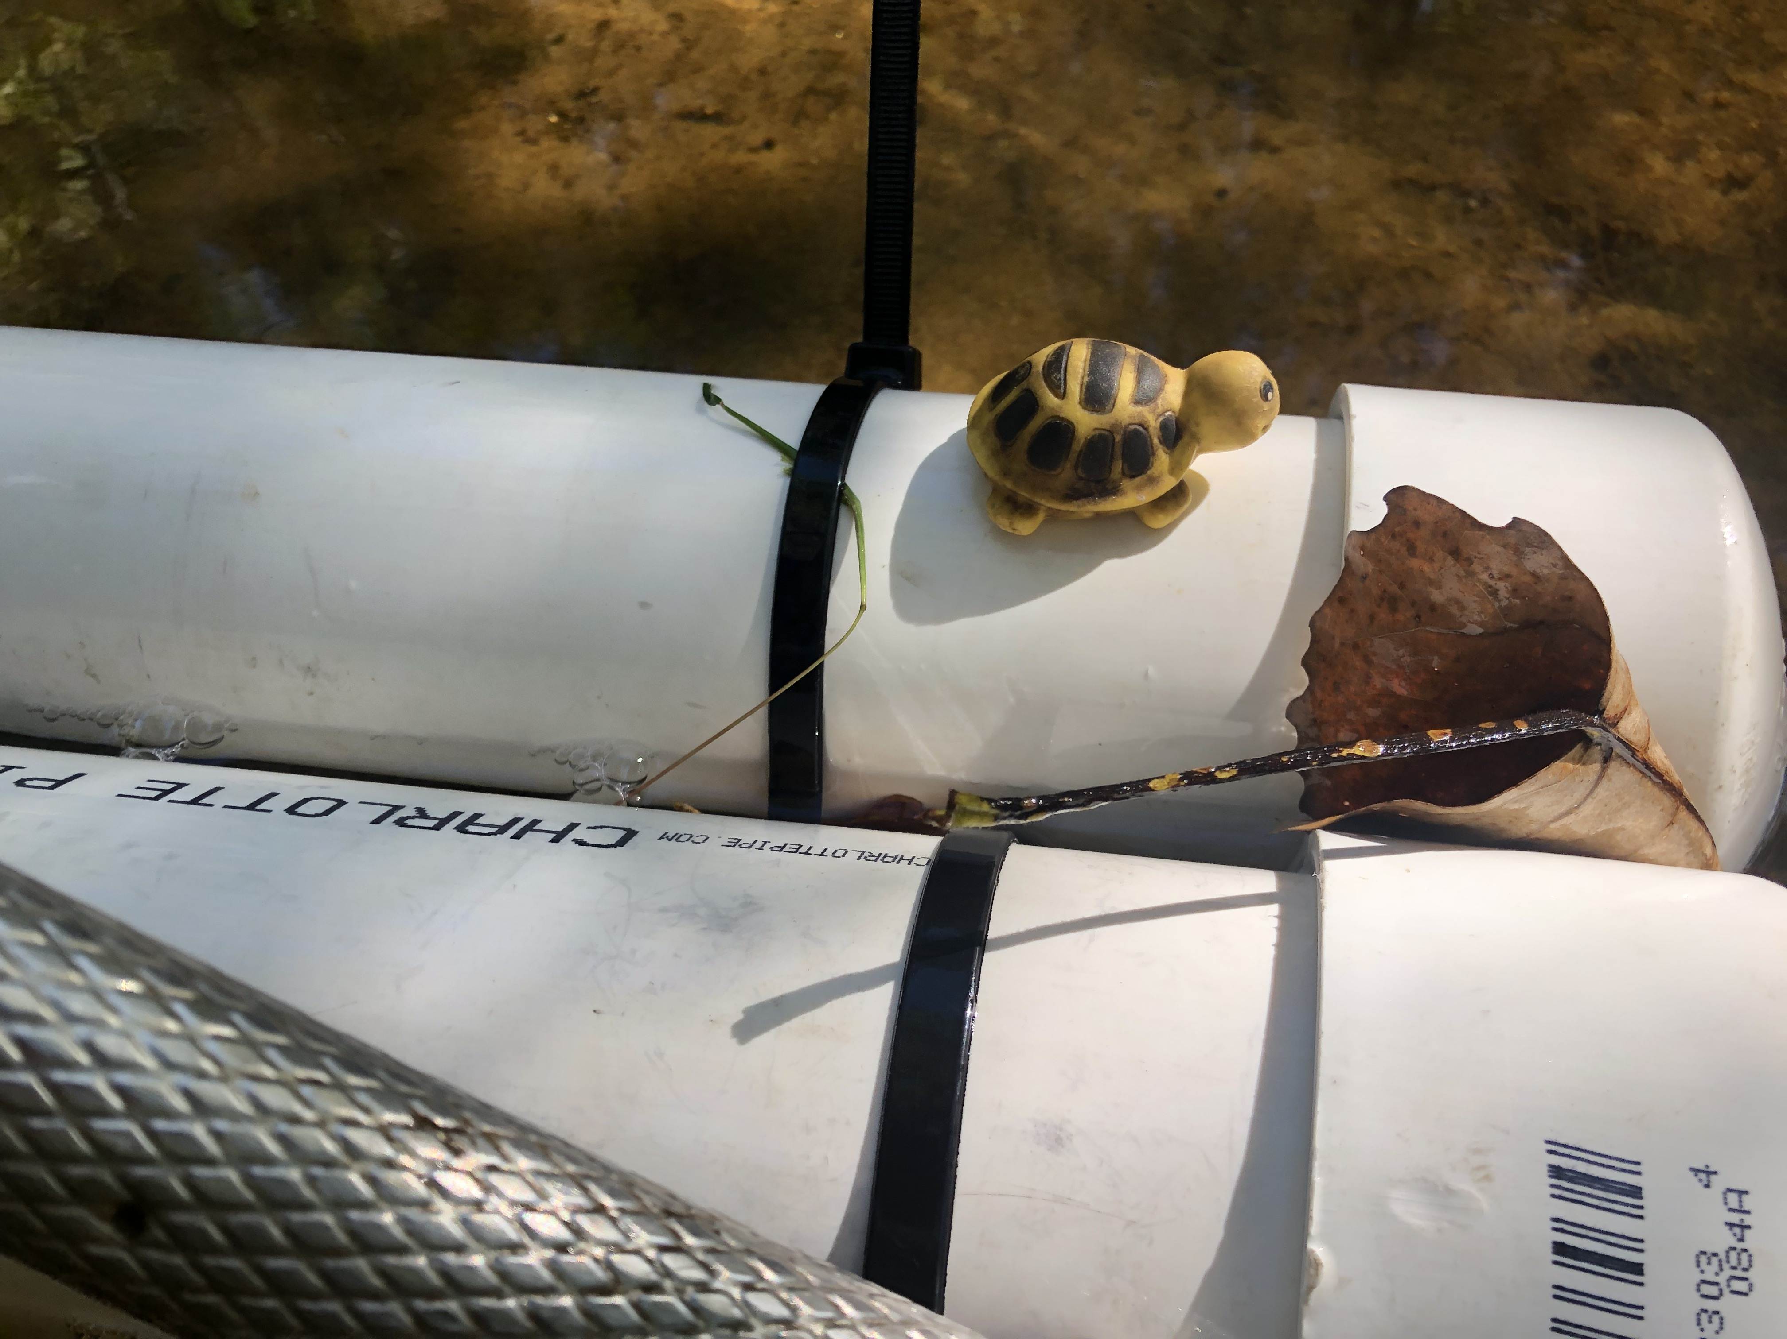
Data Collection
Oct 21-22, 2021
12 river miles
S::CAN set to collect sample once a minute
Collected 20 water samples at regular intervals to calibrate the S::CAN

Slide 8
Remote Sensing

Slide 9
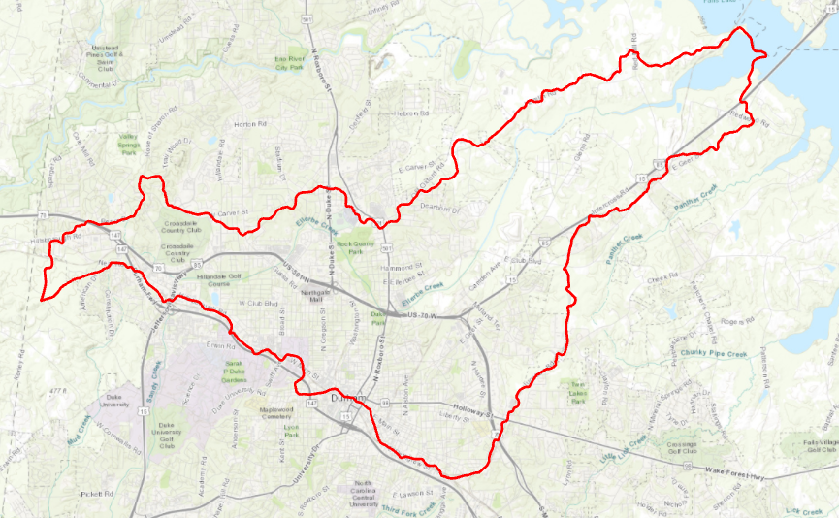
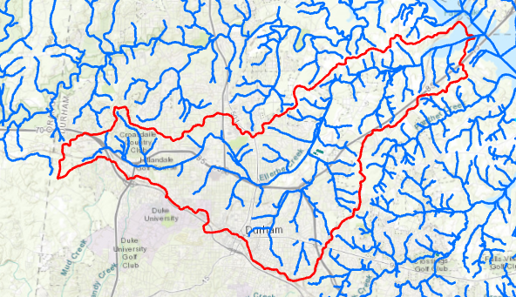
Data Sources:
Hydrologic units from USGS Streams from USGS

Slide 10
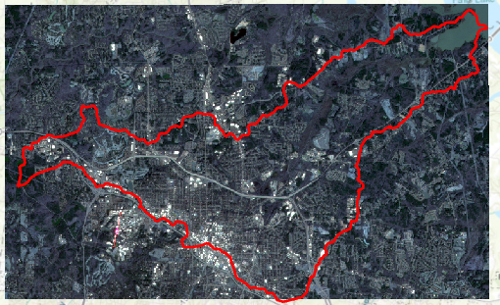
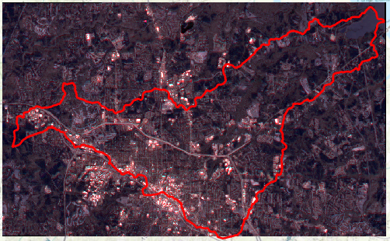
Data Sources:
Planet Data (Feb 20, 2021)
Resolution: 3m, Bands: 4
Sentinal-2 Data (Feb 10, 2021)
Resolution: 10m , Bands: 13

Slide 11
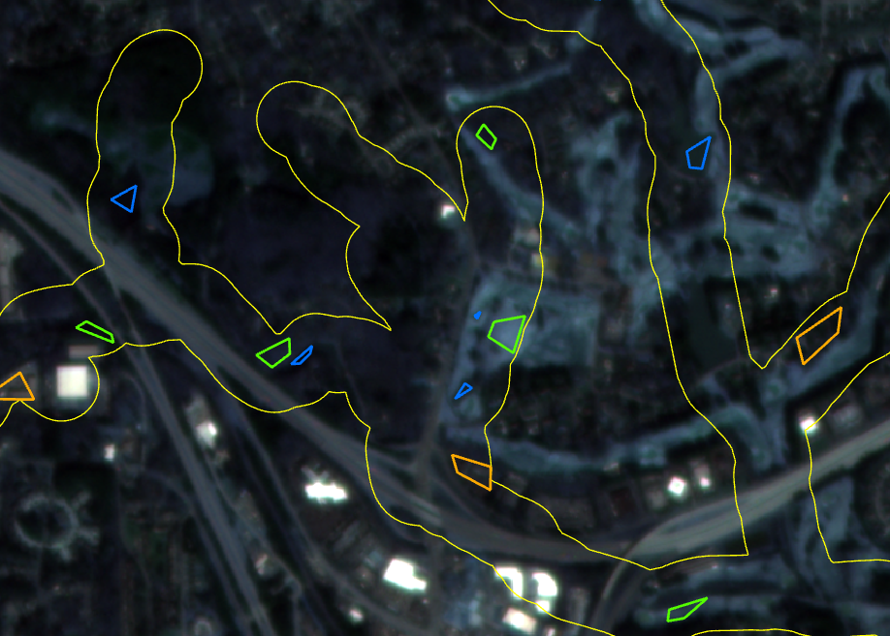
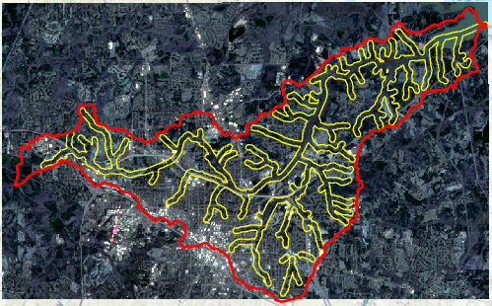
Training Polygons within 100m Buffer

Slide 12
Classifying land use
Categories:
Open water
Forest
Grass
Residential
High intensity development
Vectorised 10 polygons of each category using google earth
Random Forest Model
Split training data - 25%
Trees - 100
Random state - 8

Slide 13
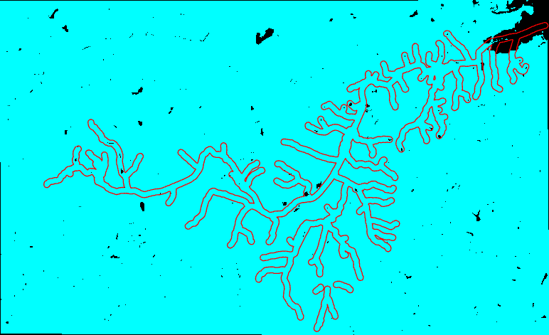
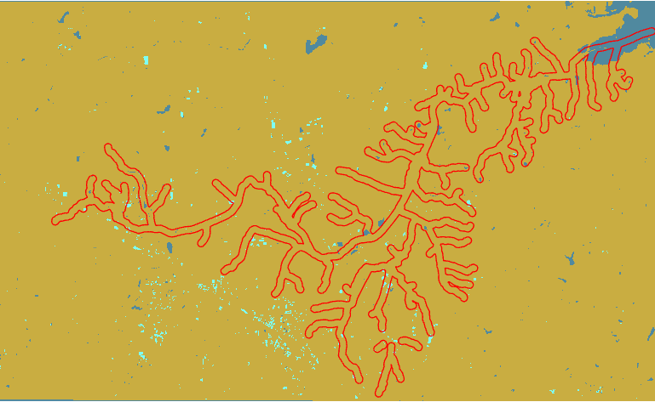
Predicted Classification (Sentinel-2)
Water vs Land
97.8% overall accuracy
Undeveloped, Developed, Water
94% overall accuracy

Slide 14
Summary of findings (methods)
Overall, Sentinel-2 data is more accurate than Planet data
Fewer categories are more accurate than more categories
Classifying land vs water was the most accurate
> 90 % for both Sentinel-2 and Planet

Slide 15
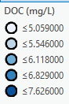
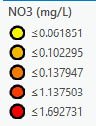
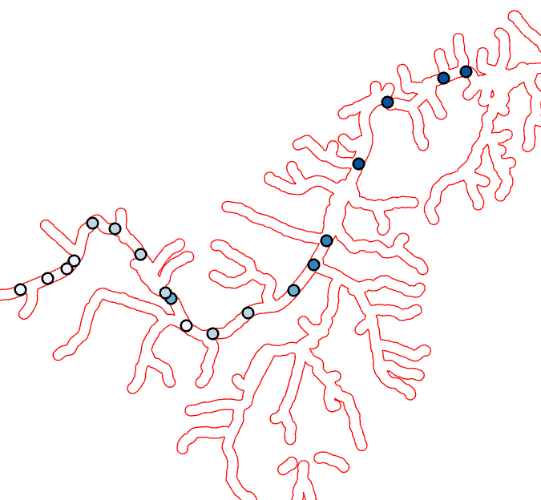
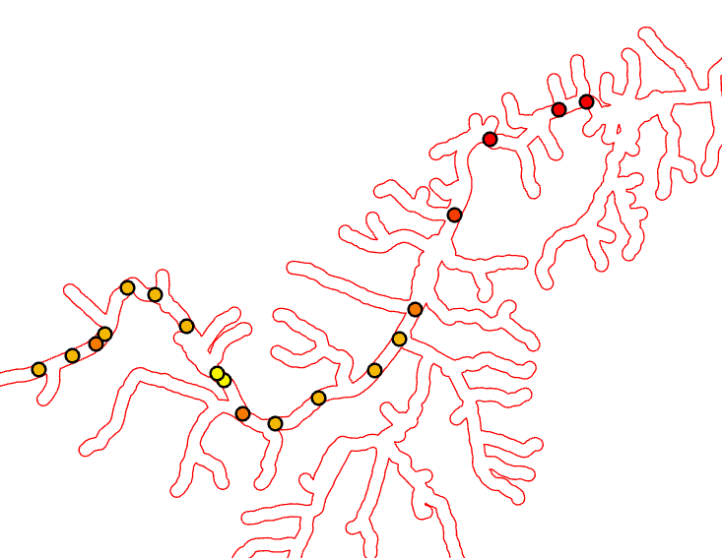
Water Chemistry (with the help of arcmap)

Slide 16
Final analysis
Summarized land classification raster
For each sample point, calculated % water and % development for 800m upstream

Slide 17
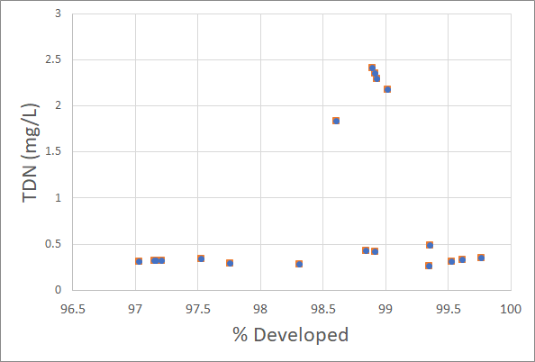
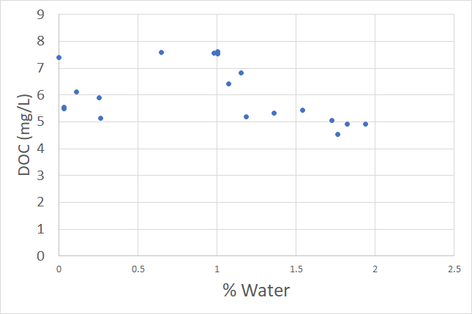
Results:

Slide 18
Conclusions:
Riparian land use does not have a large impact on water quality
Riparian land use has an impact on water quality, but are many other confounding factors
Analysis could be improved to show how riparian land use impacts water quality

Slide 19
Next Steps
Pull in high resolution data from S::CAN
Improve land use classification
Experiment with variables such as buffer width

Slide 20
Notes
Huyenbroech 2020_ Using remote sensing to characterize riparian vegetation: A review of available tools and perspectives for managers
Stutter 2021_The utility of spatial data to delineate river riparian functions and management zones: A review
Fixed buffer width is useful, but may not actually be capturing what is riparian and what is not
Extend riparian drainage to include artificial streams
Rapinel 2019_ Evaluation of Sentinel-2 time-series for mapping floodplain grassland plant communities
Coleman 2020_ A Simplified Framework for High-Resolution Urban Vegetation Classification with Optical Imagery in the Los Angeles Megacity
Supervised Random forest modelw with sentisnal-2 and NAIP data from USGS

